Slide 1

PRESENTATION ON
STUDENT MANAGEMENT SYSTEM
PRESENTED BY
Name: Israt Jahan Eva
Id: 20232006010
Name: Amena Akter
Id: 20232008010
Name : Eshita Akter
Id: 20232013010

Slide 2
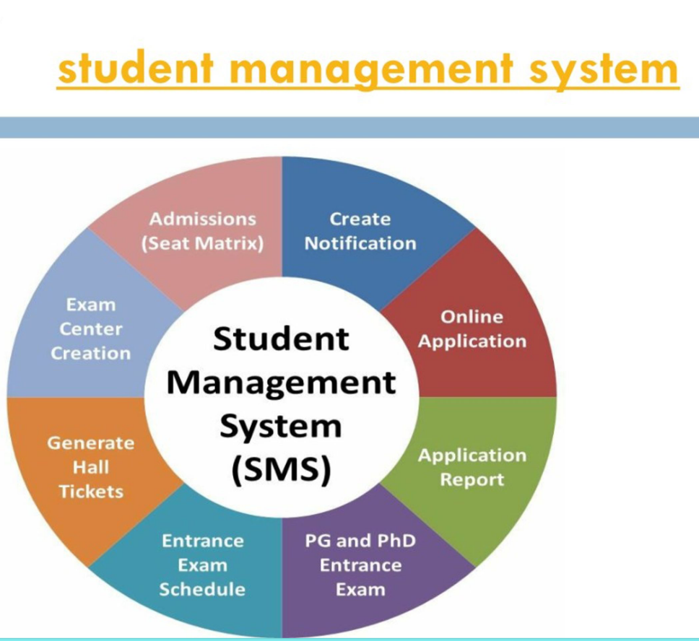
Introduction
The Student Management Application is a digital platform designed to streamline and automate administrative tasks in educational institutions. It helps manage student records, exam schedules, subjects, and notices efficiently in one system. The app provides an intuitive dashboard and user-friendly interface, ensuring quick access to essential data for teachers, students, and administrators.
Objectives
To create an efficient and easy-to-use system for managing student data.
To reduce manual work and paperwork in academic administration.
To enable real-time updates of notices, schedules, and student information.
To improve data accuracy and accessibility for teachers and staff.
To build a scalable foundation for future academic management tools.

Slide 3

Methodology
System Design: The project was developed using a modular approach, dividing components into Dashboard, Add Student, Add Subject, Exam Schedule, and Notice Board modules.
Frontend Development: HTML, CSS,javascript and Php were used to create a responsive and interactive user interface.
Backend Development: PHP and MySQL (or any chosen backend) were used to handle database management, authentication, and data storage.
Testing & Deployment: Each module was tested individually before integrating into the full system to ensure error-free performance and data consistency.
CSS
JAVASCRIPT

Slide 4
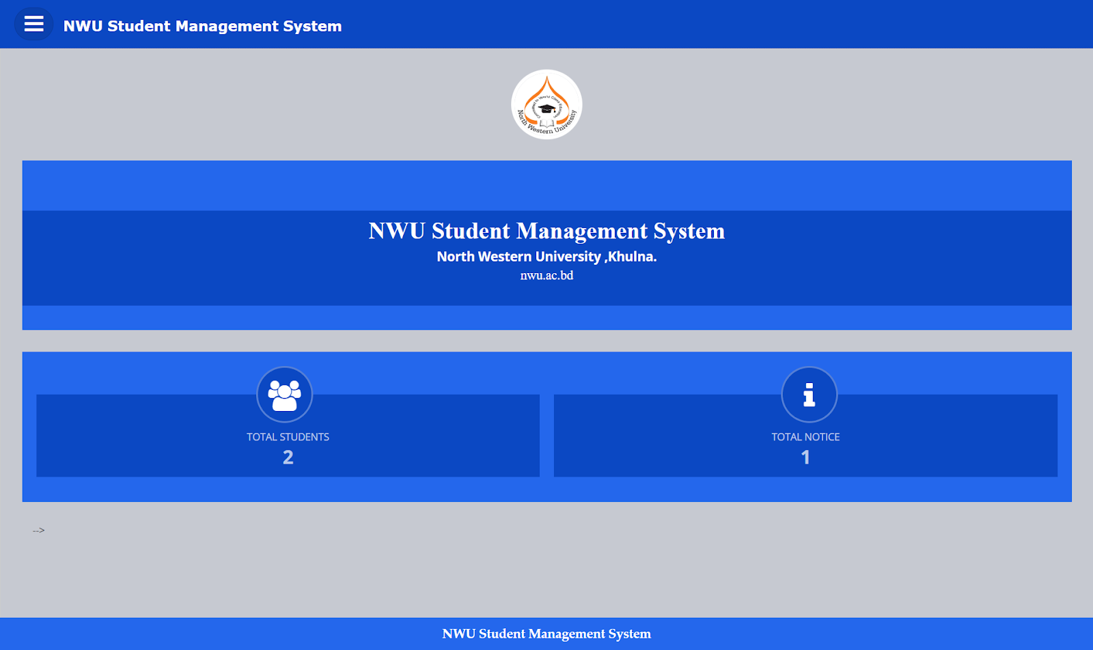
Home Page (Dashboard)
•This is the main dashboard of the Share Link application. It serves as the central hub for users, displaying key metrics and navigation options.

Slide 5
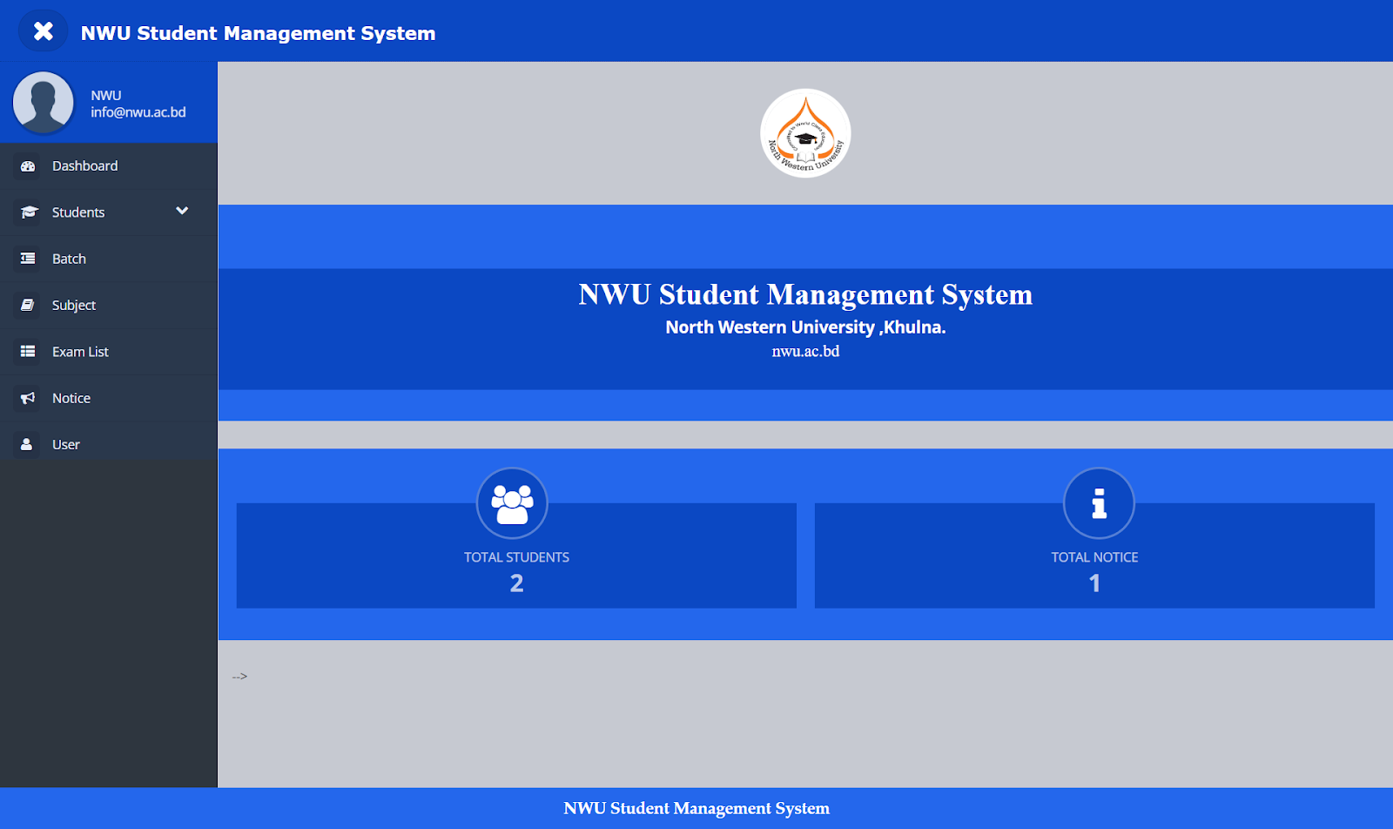
Sidebar / Menu
•The sidebar or menu provides easy navigation to different modules such as Add Student, Exam Schedule, Notice Board, and Add Subject.

Slide 6
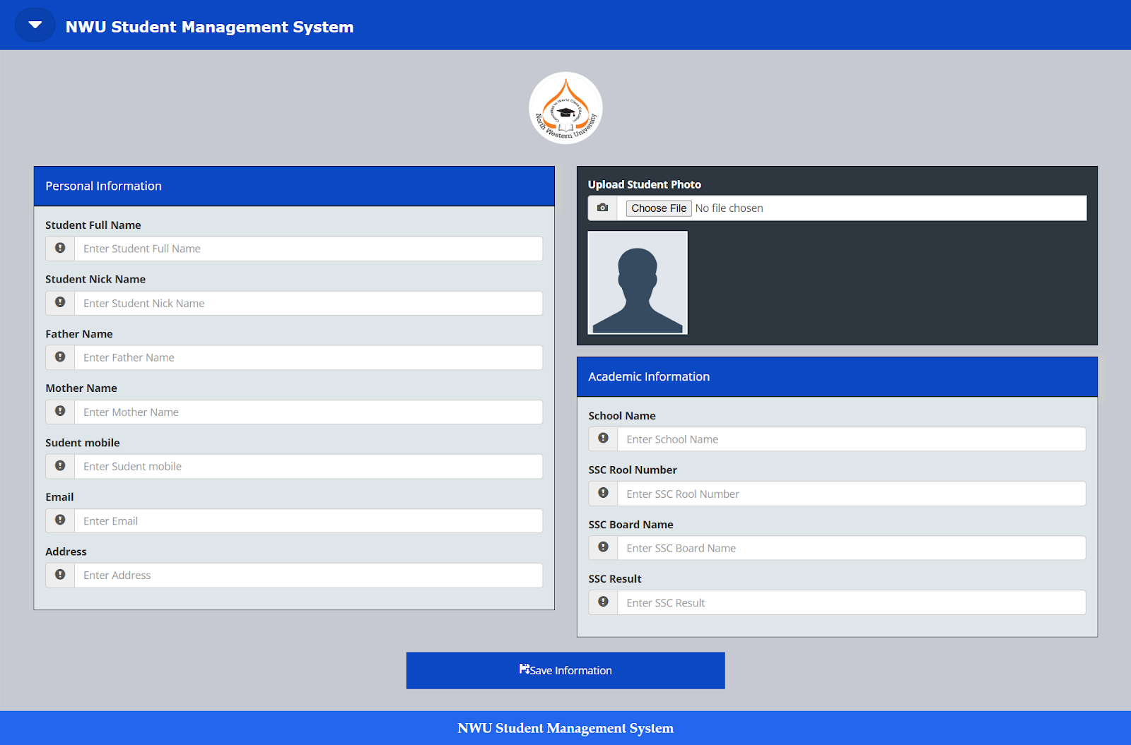
Add Student Page
•This page allows administrators or teachers to add new student details to the database. It includes fields for name, ID, class, and contact information.

Slide 7
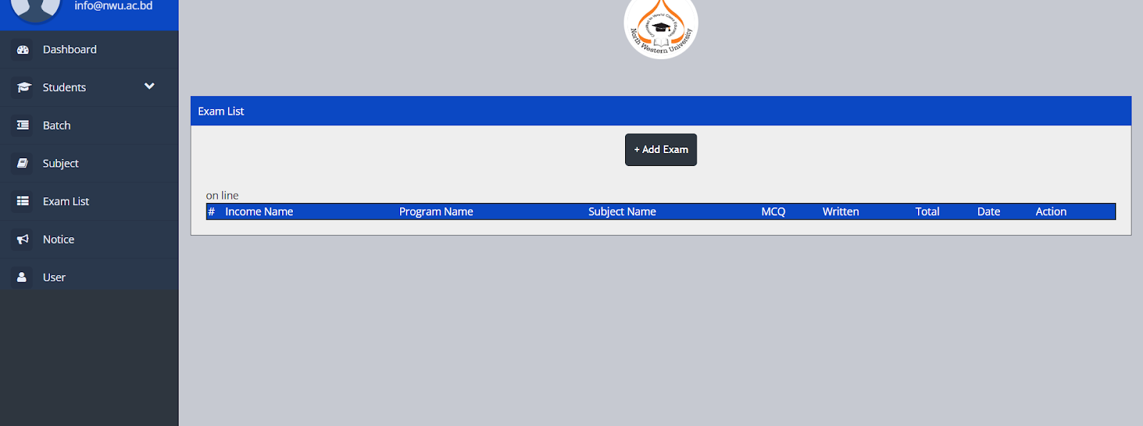
Exam Schedule Page
•This page displays and manages exam schedules. Users can add, update, or delete exam information for various subjects and classes.

Slide 8
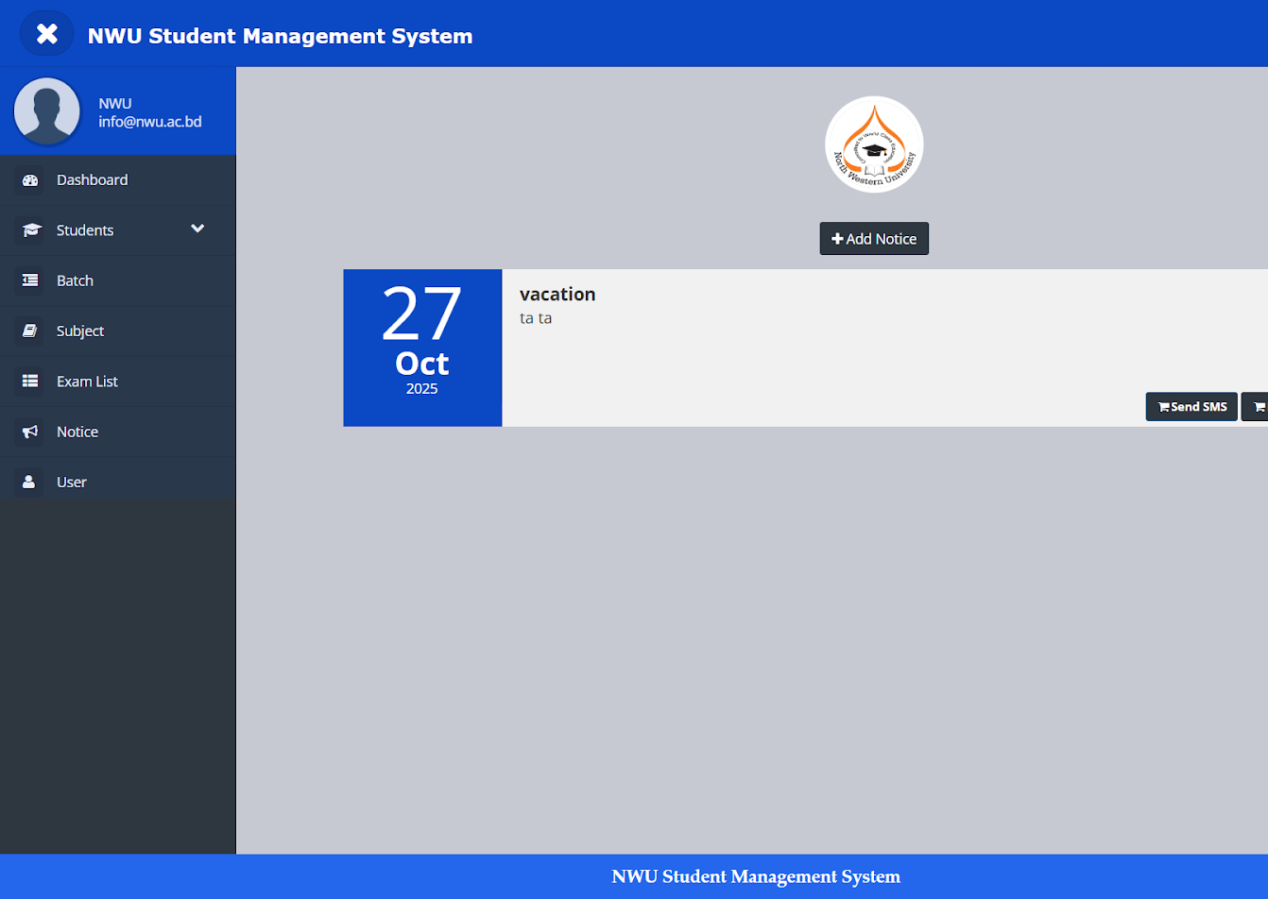
Notice Page
•The notice page shows important announcements for students and staff. It helps keep everyone updated with the latest information.

Slide 9
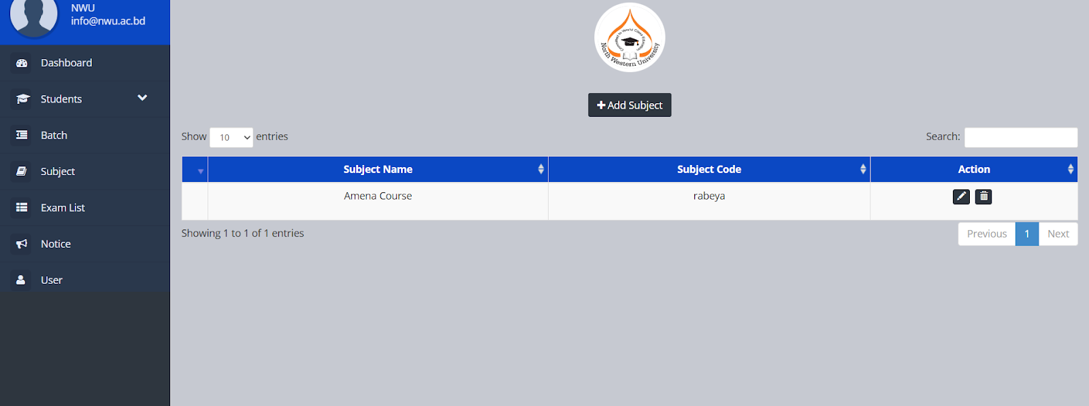
Add Subject Page
•This module enables adding and managing subjects offered in the system. Users can specify subject codes, titles, and related information.

Slide 10

Conclusion
The Student Management Application successfully automates and organizes essential academic operations. It enhances transparency, saves time, and minimizes human error. By integrating different management functions into one platform, it simplifies communication and record-keeping in educational institutions. Future upgrades can include advanced analytics, attendance tracking, and online grading systems for greater functionality.

